Slide 1
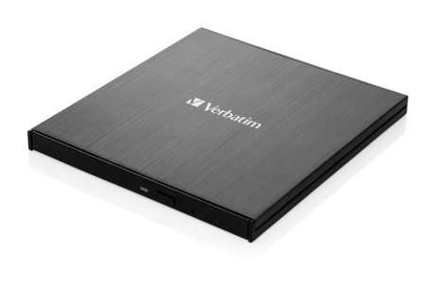

Sales Presenter
External Slimline CD/ DVD Writer
USB 3.2 GEN 1 with USB-CTM Connection
Available now
Reorder No: 43886
Warranty: 2 Year Limited Warranty
Description:
External Slimline CD/ DVD Writer with USB-CTM Connection
USB-CTM to USB-A Cable (USB-A to USB-CTM adapter also included)
USB 3.2 GEN 1.
Super slim, brushed metal enclosure ideally suited for use with a notebook or ultrabook.
Compatible with both Windows & Mac OS.
Power provided by the USB port – no need to carry a bulky power adapter.
Includes Nero Burn & Archive software* – easily create your own DVD or CD archive.
Fully compliant with MDISC™ archiving technology
Store up to 8.5GB on a Double Layer DVD. Up to 4.7GB on a standard DVD.
*Nero Burn & Archive is only suitable for Windows
Product Weight: Writer 207 grams, Cable 23 grams, Adapter 7 grams
Product Dimensions: 145mm x 133mm 11mm
Pack Weight: 353 grams (approx)
Pack Dimensions: 195mm x 179mm x 46mm
Carton Qty: Outer of 4
Carton Dimensions: 210mm x 206mm x 210mm
Layers Per Pallet: 4
Cartons / layer: 15
Units / Pallet: 240

Slide 2
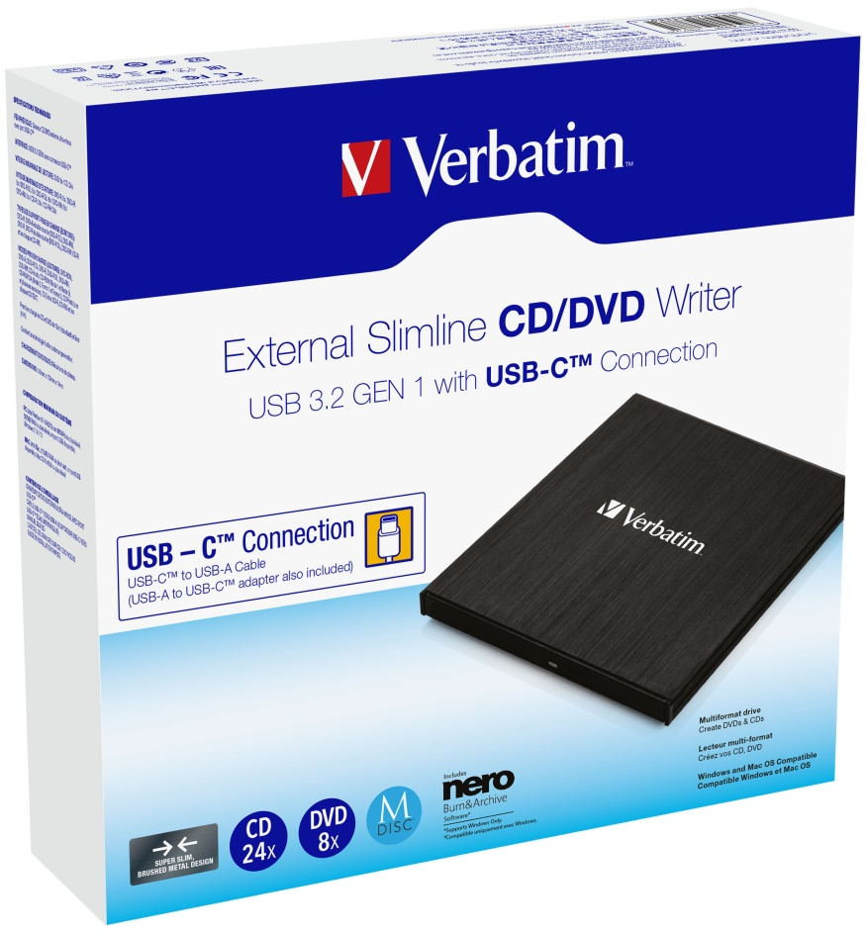
Sales Presenter
External Slimline CD/ DVD Writer
USB 3.2 GEN 1 with USB-CTM Connection
System requirements:
PC: Intel Pentium III / AMD Duron 900MHz or higher, available USB port, Windows 8/10/11
MAC: Intel Mac, available USB port, Mac OS X 10.6 or higher
Languages
Front of pack: English (Product description also in French on the back)
Back of pack: English, French, German, Italian, Spanish, Portuguese, Polish, Russian, Czech, Hungarian, Slovakian, Croatian, Traditional Chinese, Simplified Chinese & Korean
User Guide Languages:
English, French, German, Italian, Spanish, Portuguese, Polish, Russian, Czech, Hungarian, Slovakian, Dutch, Croatian, Traditional Chinese, Simplified Chinese, & Korean.
Pack Contents:
External Slimline CD/ DVD Writer USB-CTM / USB-CTM to USB-A Cable (USB-A to USB-CTM adapter also included) / Nero Burn & Archive Software on CD / Manual on CD / Quick Installation Guide
September 2023

Slide 3
Sales Presenter
External Slimline CD/ DVD Writer
USB 3.2 GEN 1 with USB-CTM Connection
Ordering Information:
Reorder No. | Description | Barcode | EAN-128 | EAN-14
43886 | Verbatim External Slimline CD/ DVD Writer USB 3.2 GEN 1 with USB-CTM Connection | 023942438861 | (02)00023942438861(37)04(91)221 | 50023942438866

