Slide 1
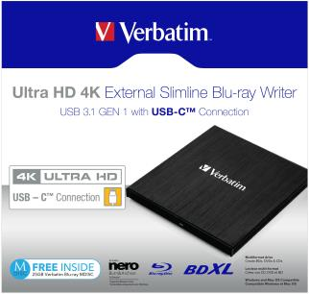

Ultra HD 4K External Slimline Blu-ray Writer
USB 3.1 GEN 1 with USB-CTM Connection
Part Number: 43888
Warranty: 2 Year Limited Warranty
Key features:
Ultra HD 4K with USB-CTM Connection
USB-CTM to USB Cable plus USB-A to USB-CTM adapter included
USB 3.1 GEN 1
Compact & lightweight, ideally suited for use with a notebook or ultrabook
Includes a FREE 25GB Verbatim Blu-ray MDISCTM
Power provided by the USB port – no need to carry a bulky power adapter
Includes Nero Burn & Archive software *– easily create your own Blu-ray, DVD or CD archive
Fully compliant with MDISCTM archiving technology
Stores up to 100GB on a BDXL Disc / 8.5GB on a double layer DVD / up to 4.7GB on a standard DVD
*Nero Burn & Archive is only suitable for PC
Product Weight: 215 grams
Product Dimensions: 145mm x 133mm 11mm
Pack Weight: 414 grams (approx)
Pack Dimensions: 195mm x 179mm x 46mm
Carton Qty: Outer of 4
Carton Dimensions: 210mm x 206mm x 210mm
Layers Per Pallet: 5
Cartons / layer: 15
Units / Pallet: 300
Includes FREE 25GB Verbatim Blu-ray MDISC
September 2023

Slide 2
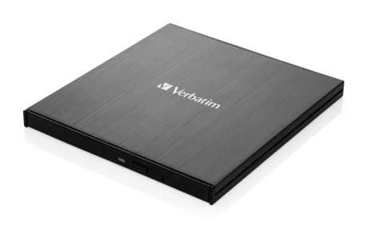

Ultra HD 4K External Slimline Blu-ray Writer
USB 3.1 GEN 1 with USB-CTM Connection
System requirements:
PC: Intel Pentium III / AMD Duron 900MHz or higher, 512MB RAM or higher, available USB port, Windows 8/10/11
MAC: Intel Mac, 512MB RAM or higher, available USB port, Mac OS X 10.6 or higher
Languages
Front of pack: English (Product description also in French)
Back of pack: English, French, German, Italian, Spanish, Portuguese, Polish, Russian, Czech, Hungarian, Slovakian, Croatian, Traditional Chinese, Simplified Chinese & Korean
User Guide Languages:
English, French, German, Italian, Spanish, Portuguese, Polish, Russian, Czech, Hungarian, Slovakian, Dutch, Croatian, Traditional Chinese, Simplified Chinese, Korean & Japanese.
Pack Contents:
Ultra HD 4K External Slimline Blu-ray Writer / USB-CTM to USB Cable plus
USB-A to USB-CTM adapter included / Nero Burn & Archive Software on CD / Manual on CD / Quick Installation Guide

Slide 3
Ultra HD 4K External Slimline Blu-ray Writer
USB 3.1 GEN 1 with USB-CTM Connection
Ordering Information:
Reorder No. | Description | Barcode | EAN-128 | EAN-14
43888 | Verbatim Ultra HD 4K External Slimline Blu-ray Writer USB 3.1 GEN 1 with USB-CTM Connection | 023942438885 | 02)00023942438885(37)04(91)221 | 50023942438880

